Slide 1
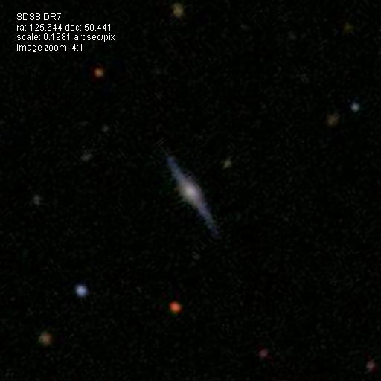
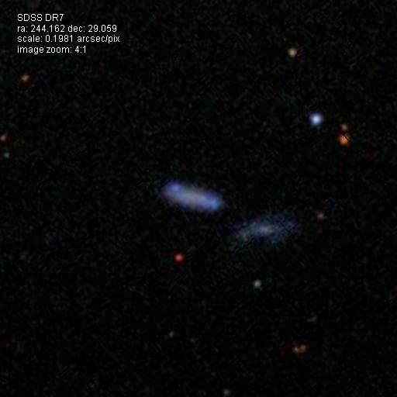
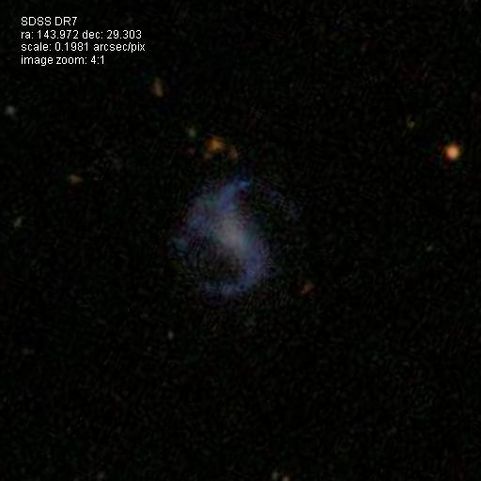


Observational Evidence of the Large-Scale Environmental Influence on Dwarf Galaxy Evolution
Kelly A. Douglass
Advisor: Prof. Michael S. Vogeley
Drexel University
7 July 2017
Notes:
Examples of some of the dwarf galaxies studied

Slide 2
Chemical abundances, dark matter, and the cosmos
Kelly A. Douglass
Department of Physics, Drexel University
Notes:
Metallicity (O/H) dependence
N/H and N/O dependence

Slide 3
Is there an environmental influence on the chemical evolution of dwarf galaxies?
ΛCDM cosmology predicts galaxies to evolve differently based on their environment (Gottlöber et al. 2003, Goldberg et al. 2005, Cen 2011)
Previous studies measured extremely low metallicities in some void galaxies (Pustilnik et al. 2006, Cooper et al. 2008, Deng 2011, Pustilnik et al. 2011, Pustilnik et al. 2013, Pustilnik 2014, Filho et al. 2015) – Is this a pattern?
Notes:
ΛCDM cosmology predicts void galaxies to have lower masses and be retarded in their star formation when compared to galaxies in more dense environments
Previous surveys found a population of void dwarf galaxies that are metal-poor (12 + log(O/H) < 7.6)

Slide 4
Presentation overview
Data and environmental classification
Analysis
Direct T_{e} method
O⁺ approximation
Results and interpretation
O/H
N/O

Slide 5
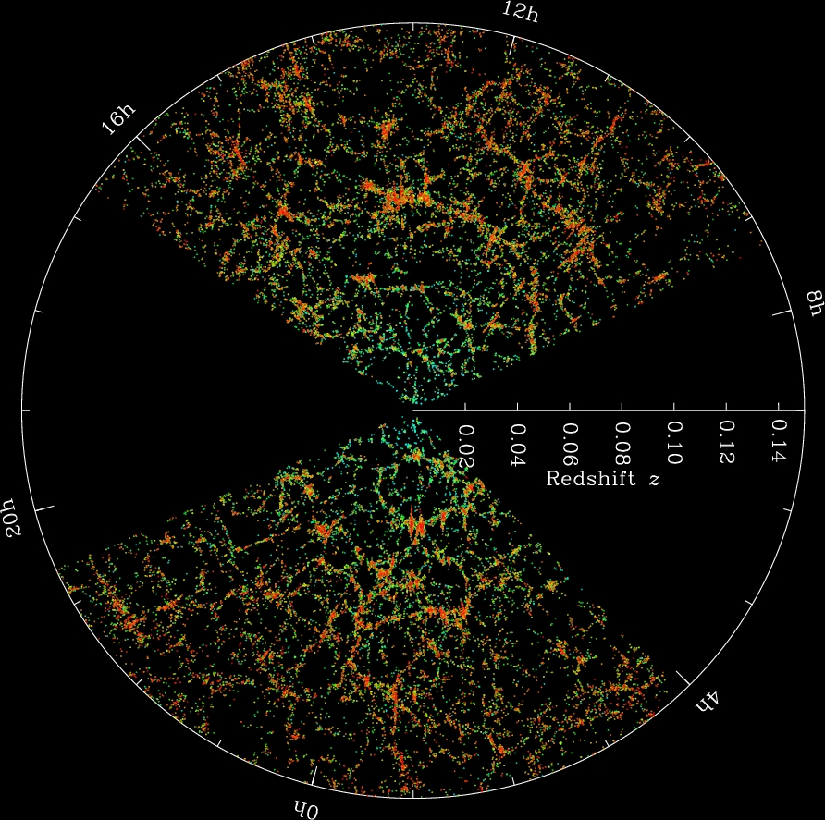
The cosmic web
The large-scale structure of our universe is a non-uniform, sponge-like distribution of galaxies.
SDSS galaxy map – www.sdss.org
Notes:
Large sky surveys (such as SDSS) have revealed a non-uniform distribution of galaxies throughout the universe. Dubbed the Cosmic Web, galaxies clump together in clusters and along filaments, leaving giant gaps between them (similar to a sponge). What would cause this type of structure?
D = cz/H = (3e5/100)*z = 3000*z h^-1 Mpc = 9e9*z lightyears
This diagram is 450 h^-1 Mpc in radius, or 900 h^-1 Mpc in diameter, or about 4 billion light years across. For scale, the closest star to our Sun is 4 light years away. We are 8 kpc from the center of the Milky Way, or 26,000 light years.

Slide 6
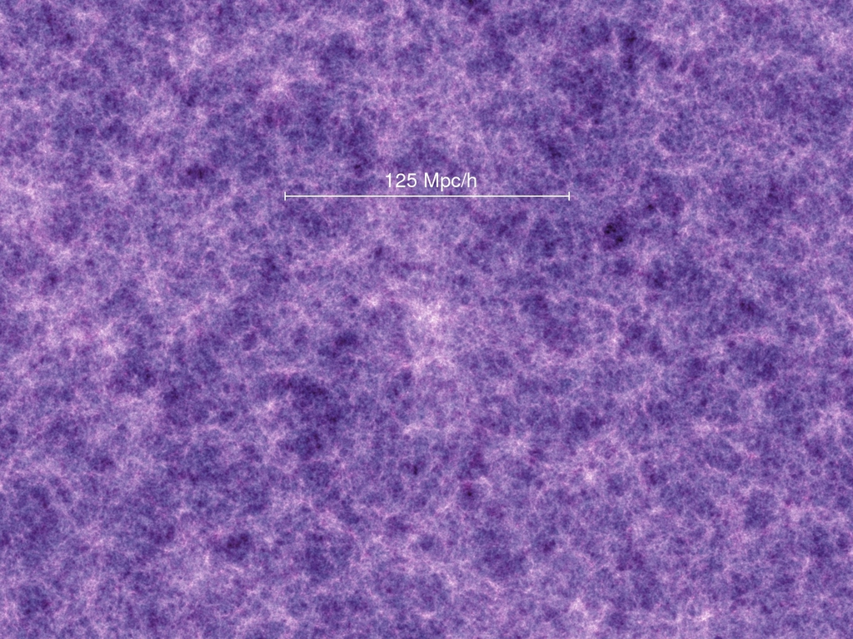
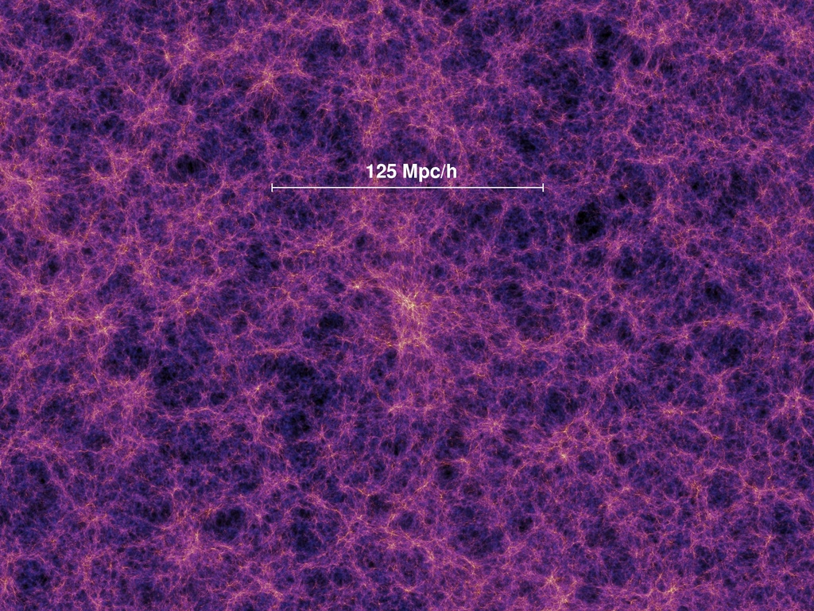
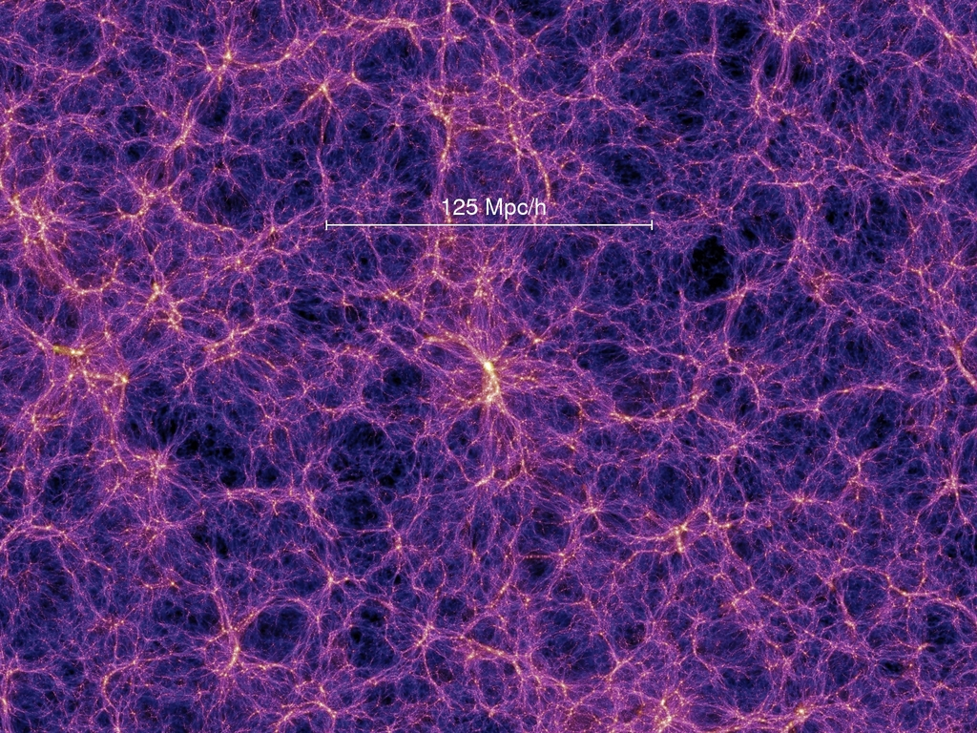
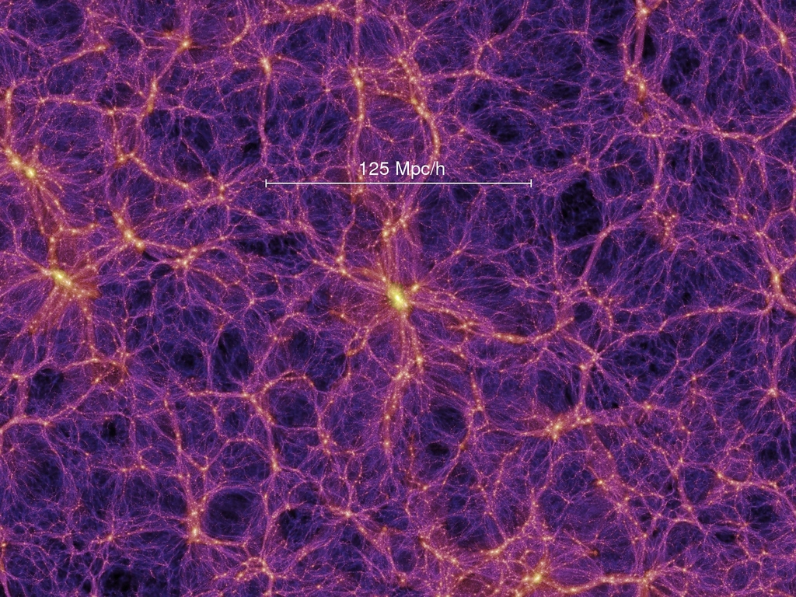
Dark matter simulation
z = 18.3 (t = 0.21 Gyr)
z = 5.7 (t = 1.0 Gyr)
z = 1.4 (t = 4.7 Gyr)
z = 0 (t = 13.6 Gyr)
Baryonic matter is expected to trace the dark matter structure.
Millennium Simulation project – wwwmpa.mpa-garching.mpg.de
Notes:
Can we reproduce this structure? Yes – small perturbations in the initial distribution of dark matter were amplified while the universe expands. Gravity caused the slightly more dense regions to contract more, while simultaneously causing the less dense regions to expand.

Slide 7
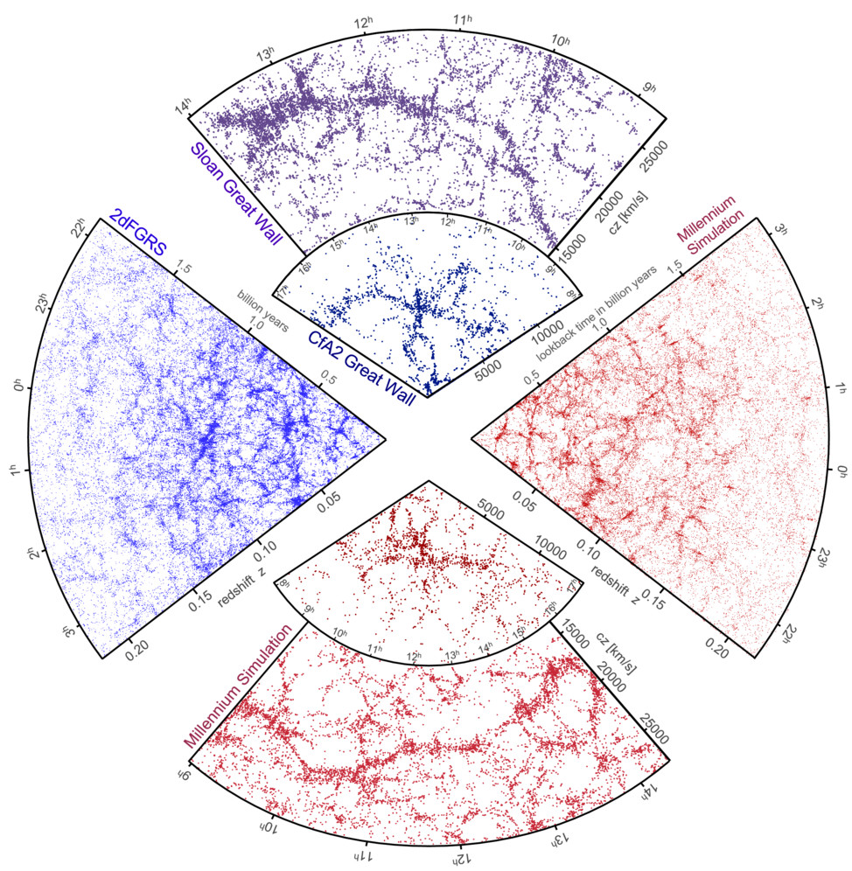
Simulations match observations on the large scale
Observations
Simulations
Millennium Simulation project – wwwmpa.mpa-garching.mpg.de
Notes:
We can successfully reproduce the large-scale structure of the universe with dark matter simulations. But what does the dark matter look like on smaller scales? How can we test the accuracy of the simulations on galactic scales? What is the relationship between dark matter halos and star formation?

Slide 8
How does the large-scale environment affect galaxy evolution?
Define the galaxy’s environment
Use the smallest galaxies possible
Determine physical properties of the galaxies from spectroscopy
How do the properties of the gas and the history of star formation depend on the environment? What does this tell us about the dark matter structure and history of the galaxy?

Slide 9
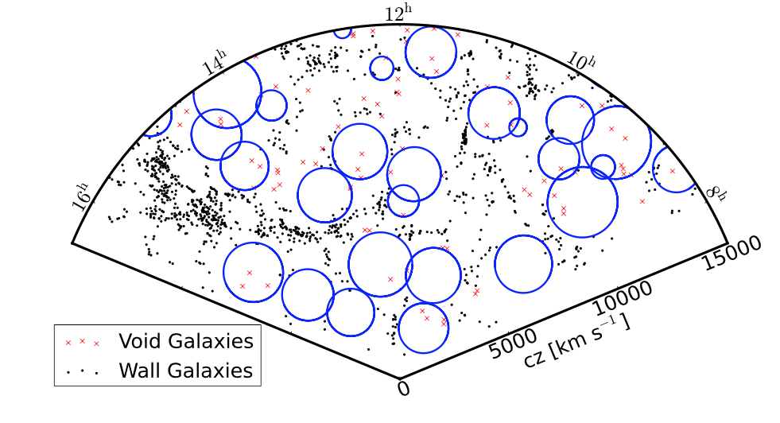
Void galaxies
Moorman et al. (2014)
Existing in the cosmological voids (space between galactic filaments), void galaxies are thought to demonstrate the fundamental characteristics of galactic evolution.
Notes:
What are void galaxies? Just as stars clump together to form galaxies, galaxies clump together into filaments, leaving some regions with few galaxies. Those galaxies found within these voids are thus named ‘void galaxies.’
Why do we want to study them? As galaxies move through space, they interact via collisions, etc. Gases are exchanged between them regularly, and often the collisions cause a burst of star formation. Since there are so few galaxies in the voids, they interact far less often than those in the filaments. This causes them to be more ‘pure,’ allowing us to study them to discern how a single galaxy would naturally evolve.
There is more cool gas available to fuel star formation up to the present in voids.
Voids provide an important test of galaxy formation theory to compare against more dense regions.
60-70% of the universe is filled with voids
Minimum radius of a void is 10 h^-1 Mpc, or about 50 million light years across
***VoidFinder is based on a third nearest-neighbor algorithm to locate and remove field galaxies, after which maximal spheres are grown between the remaining wall galaxies.

Slide 10
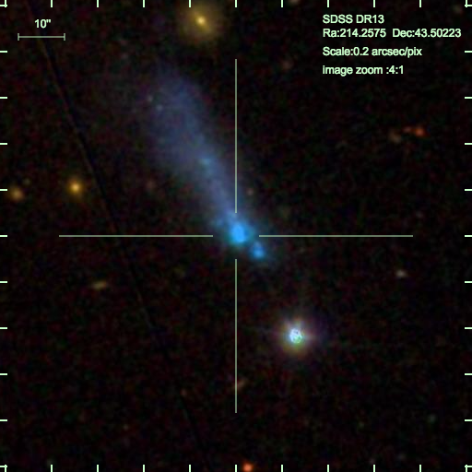
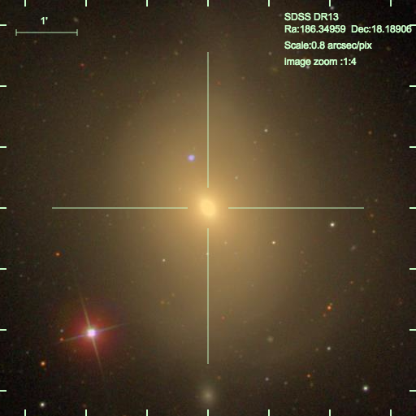
The influence of the large-scale environment: What we know so far
Voids
Walls
Blue spiral and irregular galaxies
Currently forming stars
Red elliptical galaxies
No longer forming stars

Slide 11
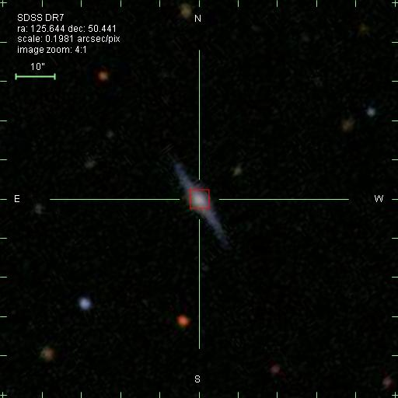
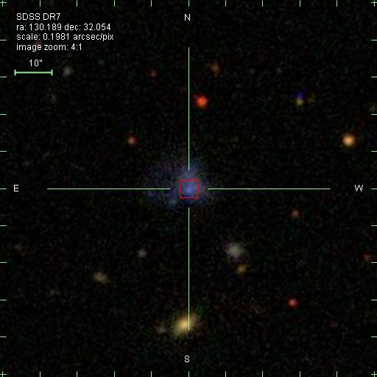
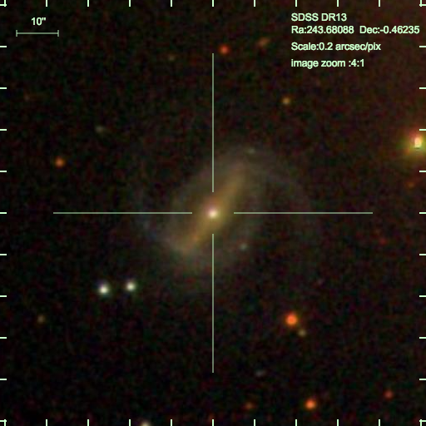
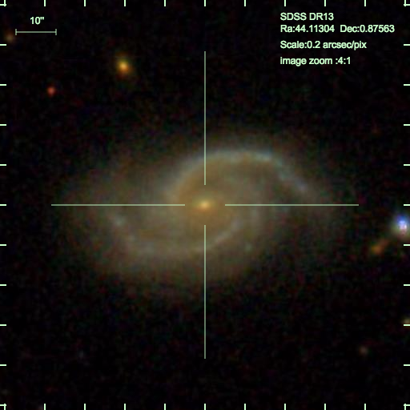
Dwarf galaxies
Galaxies fainter than M_{r} = -17
Low stellar masses (10⁶ – 10⁹ M)
More sensitive to environmental effects
Milky Way
Dwarf galaxies
Notes:
The lower stellar masses of dwarf galaxies corresponds to a smaller gravitational potential well. This causes any environmental effects (including interactions with other galaxies) to have a stronger influence on dwarf galaxies than on galaxies with larger masses.
Galaxy images are at the same scale (Images are ~100” across)

Slide 12
SDSS data & void catalog
SDSS DR7 main sample
800,000 galaxies in main spectroscopic survey
11,050 dwarf galaxies
VoidFinder algorithm used to identify voids in SDSS DR7 (Pan et al. 2012)
Minimum radius of 10 h⁻¹ Mpc
Moorman et al. (2014)
Notes:
VoidFinder is based on a third nearest-neighbor algorithm to locate and remove field galaxies, after which maximal spheres are grown between the remaining wall galaxies.

Slide 13
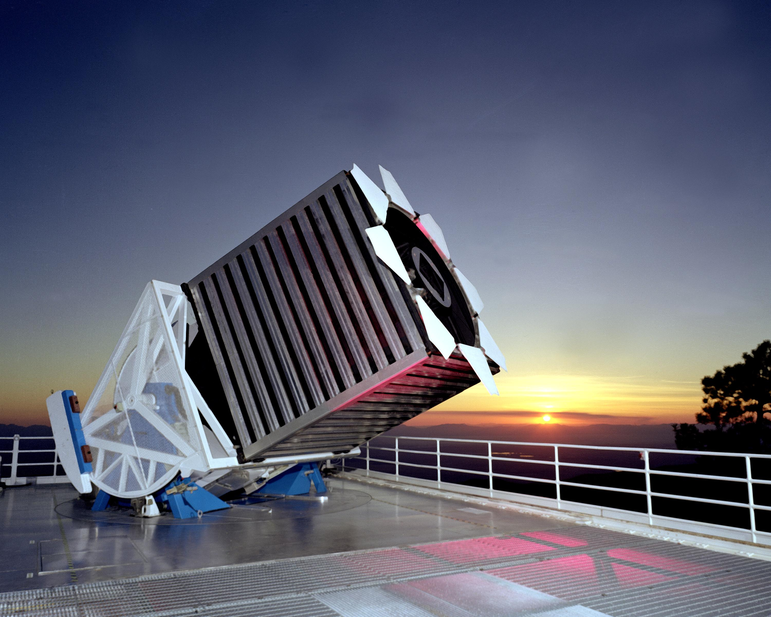
Sloan Digital Sky Survey DR7 (SDSS)
Large photometric and spectroscopic survey covering approximately ¼ of the sky
Data taken with 2.5-meter telescope at Apache Point Observatory in New Mexico
Spectra are within a rest wavelength range of 3800Å to 9200Å with a resolution λ/Δλ≈1800
Of about 800,000 galaxies in the main spectroscopy survey, only about 11,050 are dwarf galaxies!

Slide 14
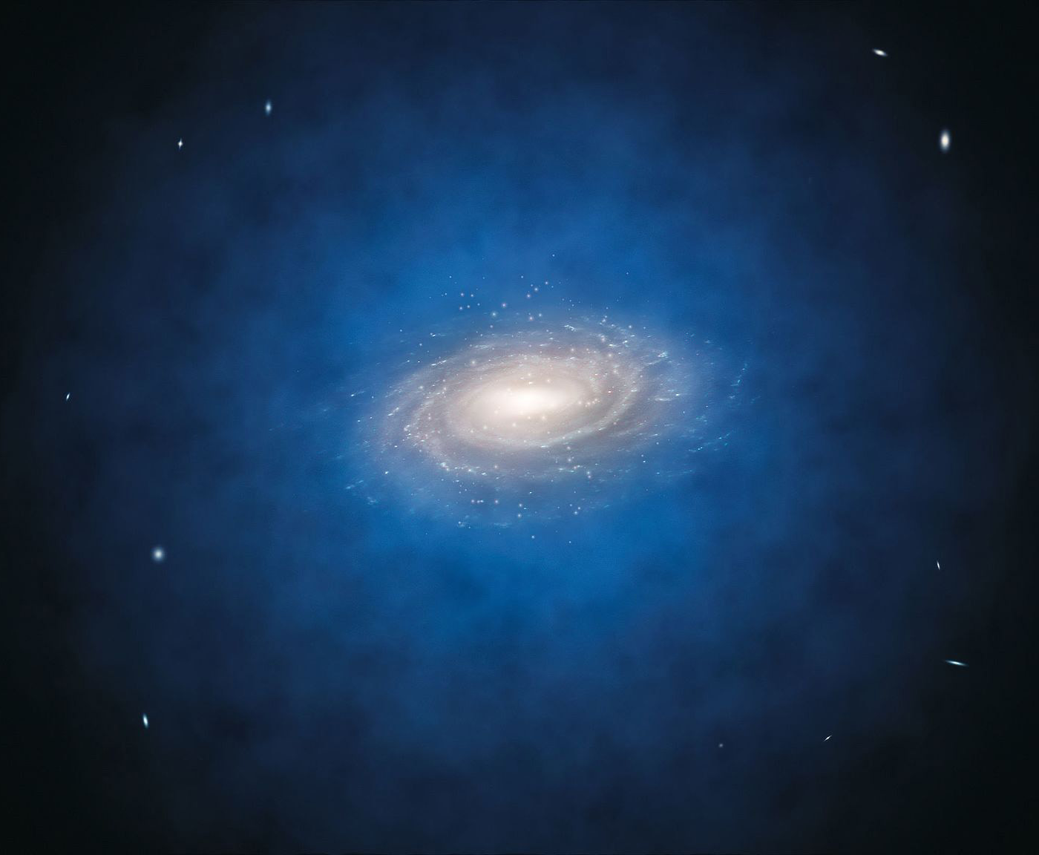
Galaxy structure
Dark matter halo
Stars & gas
Notes:
The stars within a galaxy are surrounded by gas. While galaxies are typically disk-like, they are at the center of a ball of dark matter.
About 75% of a galaxy’s mass is in its DM halo. Most of the remainder of a galaxy’s mass is in its stars (gas mass equals 10-15% of the total stellar mass).

Slide 15
Metallicity – The ratio of heavy elements to hydrogen
H
H g He
He g C, O
C g O, Ne
Ne g O
Stellar nucleosynthesis: H g He g C g Ne g O g Si
Notes:
Astrophysicists are lazy bastards – anything heavier than hydrogen and helium is grouped under the label ‘metal.’ The first stars are thought to have had only hydrogen (and maybe some helium). As stars burn, nucleosynthesis creates heavier elements at the core. When the stars die (explode, etc.), the heavier elements are enveloped into the surrounding interstellar gas. When new stars form from this gas, they include both hydrogen and some heavier elements. By measuring the amount of metals in the galaxy (metallicity), we can get a feel for the age and star formation history of the galaxy.
When more massive stars die and supernova, even heavier elements (up through iron) form. We, and everything around us, are made from elements originally formed in the center of a star.

Slide 16
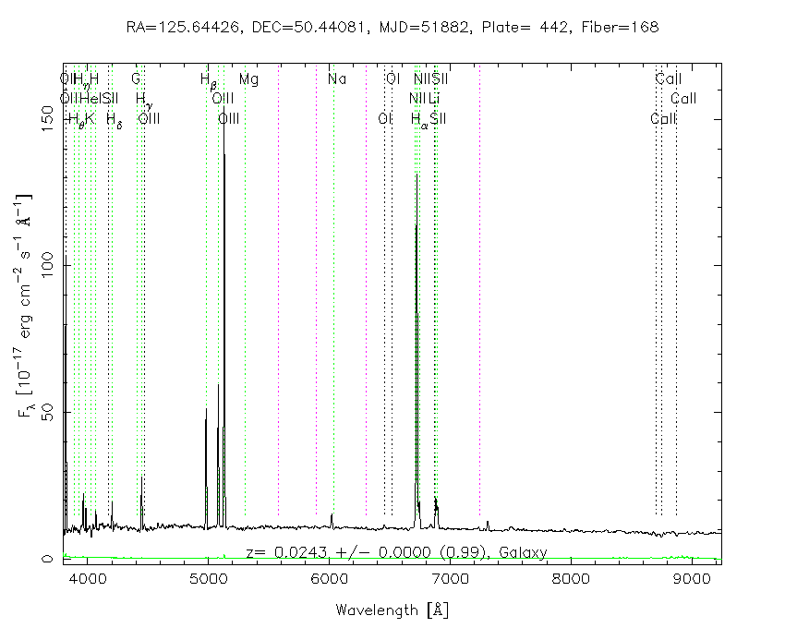
It all comes from light
Everything we know and understand about a galaxy comes from its light.
SDSS DR7 galaxy spectrum – www.sdss.org
Notes:
How do we understand what is going on in the galaxy? How is it possible to figure out the physical properties of the gas in a galaxy?

Slide 17
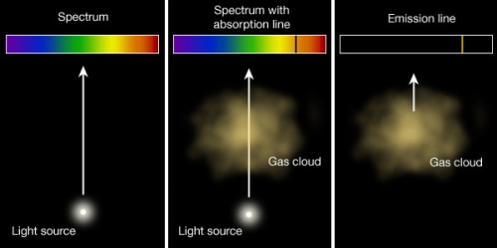
Kirchhoff’s Laws of Spectroscopy
Star
Star through gas
HII region
Notes:
A luminous solid, liquid, or dense gas emits light at all wavelengths.
A low-density, cool gas in front of a hotter source of a continuous spectrum creates an absorption line spectrum.
A low-density, hot gas against a cooler background emits an emission line spectrum.
HII regions are collections of low-density gas partially ionized by UV photons emitted from the new stars.
A galaxy’s spectrum is a combination of light from the stars and light reradiated from clouds of gas (HII regions). My measurement of the chemical abundances uses the emission lines from the gas – we are measuring the abundances of the elements produced in previous generations of stars.

Slide 18
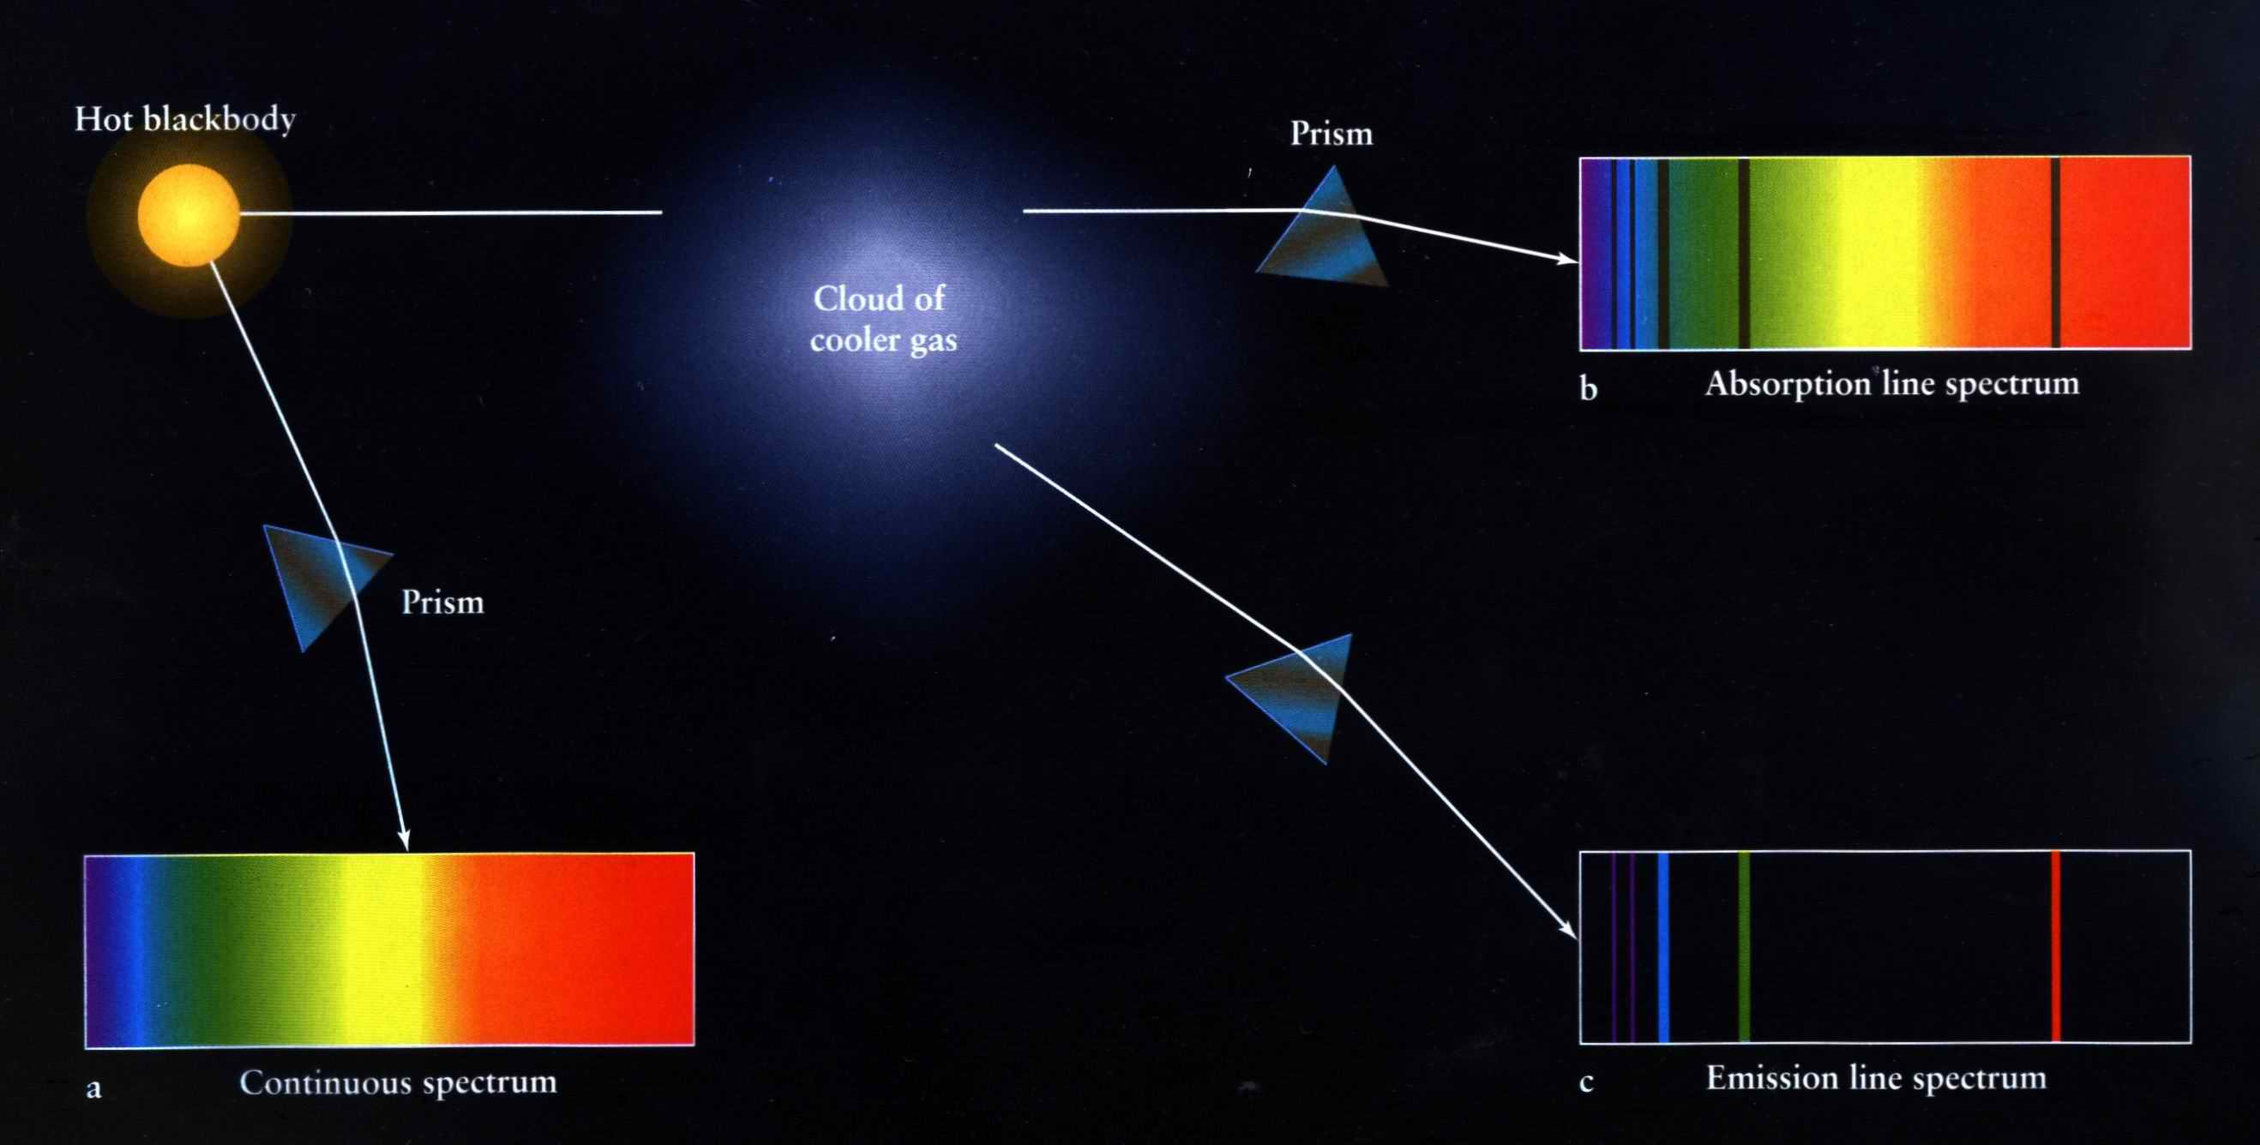
Kirchhoff’s Laws of Spectroscopy
A galaxy’s spectrum is a superposition of light from the stars and emission lines from the gas.
Notes:
A luminous solid, liquid, or dense gas emits light at all wavelengths.
A low-density, cool gas in front of a hotter source of a continuous spectrum creates an absorption line spectrum.
A low-density, hot gas against a cooler background emits an emission line spectrum.
HII regions are collections of low-density gas partially ionized by UV photons emitted from the new stars.
A galaxy’s spectrum is a combination of light from the stars and light reradiated from clouds of gas (HII regions). My measurement of the chemical abundances uses the emission lines from the gas – we are measuring the abundances of the elements produced in previous generations of stars.

Slide 19
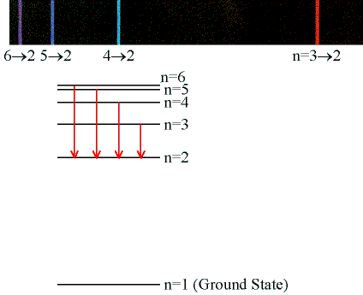
Forbidden Emission Transitions
“Classical” transitions – electric dipole selection rules
Forbidden transitions – result of magnetic dipole and/or electric-quadrupole transitions
Lifetimes
“Classical” transitions: 10⁻⁶ s
Forbidden transitions: 10⁻¹ – 10⁴s
Notes:
Forbidden emission lines – forbidden transitions by electric-dipole selection rules, but allowed by magnetic-dipole and/or electric-quadrupole transitions.
These transitions depend strongly on the temperature and density of the electrons – the atoms can easily be collisionally de-excited.
Lifetimes (inverse of transition probability):
[OIII] 4363 = 0.556s
[OIII] 4959 = 149.25s
[OIII] 5007 = 50.0s
[OII] 3726 = 5,555.56s
[OII] 3728 = 27,777.76s
[NII] 6584 = 333.33s
[SII] 6716 = 3846.15s
[SII] 6731 = 1136.36s

Slide 20
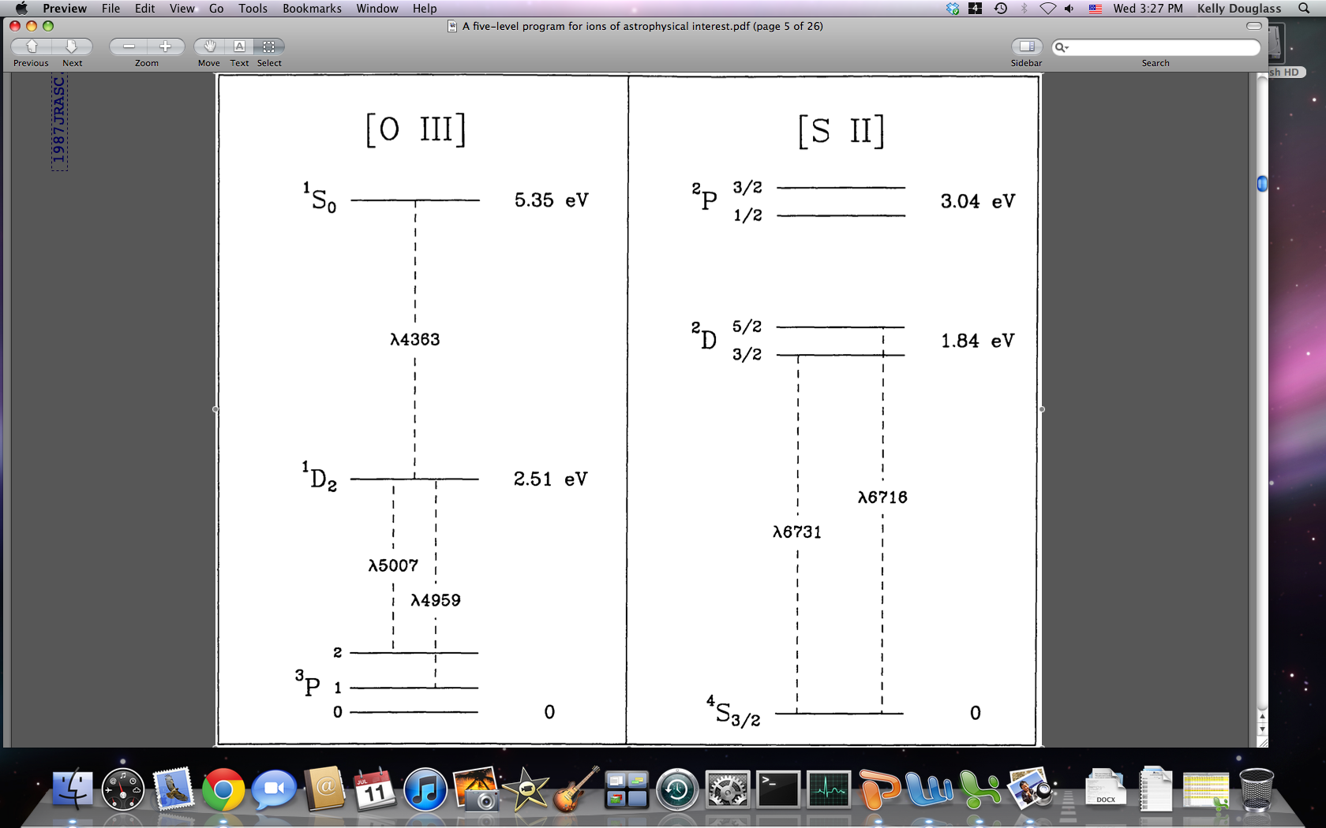
[OIII] – Temperature
Temperature-dependent excitation rates
λ4363 is difficult to detect in faint Hii regions
Oxygen emission is the most effective cooling source, so lower metallicities correspond to higher temperatures
De Robertis et al. (1987)
Notes:
Energy levels for O have excitation potentials on order of kT, so the relative strength of these emitted lines can be used to measure electron temperature. (from Osterbrock)
Because [OIII] 4363 is so weak, it is difficult to detect in faint regions (and therefore at higher redshifts).

Slide 21
[SII] – Density
Density-dependent ratio if the lines have the same excitation energy but different de-excitation rates
Low-density limit of n_{e} = 100 cm⁻³ assumed
De Robertis et al. (1987)
Notes:
The average electron density can be found by observing the effects of collisional de-excitation, which can be done by comparing the intensities of two lines of the same ion emitted by different levels with nearly the same excitation energy (so the ratio will only depend on the ratio of collision strengths). If the two levels have different radiative transition probabilities or different collisional de-excitation rates, the relative populations will depend on the electron density (so the ratio of the intensities will also depend on the electron density).
(from Osterbrock)

Slide 22
Different metallicity methods
Categories
Method used
Direct method
Theoretical methods
Empirical methods
Direct T_{e}
direct method
Notes:
Direct – measure [OIII] 4363 line to get temperature
Theoretical – based on photoionization models
Empirical – indirect estimate of temperature based on its relationship with other strong-line ratios

Slide 23
Spectroscopy reveals gas properties
[OIII] is temperature-sensitive
[SII] is sensitive to the electron number density
Flux
λ4363
Wavelength [Å]
Douglass & Vogeley (2017a)
SDSS DR7 galaxy spectrum – www.sdss.org
Notes:
Temperature-dependent excitation rates
λ4363 is difficult to detect in faint Hii regions
Oxygen emission is the most effective cooling source, so lower metallicities correspond to higher temperatures
Energy levels for O have excitation potentials on order of kT, so the relative strength of these emitted lines can be used to measure electron temperature. (from Osterbrock)
Possible to calculate the number ratios for all heavy elements with respect to H once the electron temperature and density of the interstellar gas are measured

Slide 24
Ratio of O⁺ to O⁺⁺
Low-metallicity galaxies dominated by O⁺ will be affected by an overestimate of the temperature in the low-ionization region.
Notes:
As found by Andrews & Martini (2013), the approximation we use for the temperature of singly-ionized oxygen can overestimate the temperature at the high end. This will only affect those galaxies with low metallicities (high temperatures) dominated by singly-ionized oxygen. Since this affects less than 20 of our galaxies, it does not affect our results.

Slide 25
Oxygen abundance
Metallicity often described in terms of the oxygen abundance O/H
Temperature from [OIII] line ratio
Density from [SII] line ratio (=100 cm⁻³)
T_{e} & n_{e} & flux → abundance
Notes:
Oxygen is used because it is the most abundant element in the universe (after hydrogen and helium), and it has emission lines in the optical range (so we can easily observe it).

Slide 26


Accounting for ions of O & N
For oxygen,
Can only observe N⁺ - must use an Ionization Correction Factor (ICF)

Slide 27
Comparison to Yin et al. (2007)
Notes:
To test my code, I calculated the metallicity for those galaxies studied in Yin et al. (2007), who also use the Direct method by Izotov et al. (2006). THESE GALAXIES ARE NOT PART OF OUR SAMPLE.

Slide 28
Galaxy selection criteria
Dwarf galaxies: M_{r} > -17
z < 0.03: SDSS is a magnitude-limited survey
Star-forming: ultraviolet photons are needed to excite interstellar gas
All required lines must be emission lines
Minimum 5σ detection of Hβ
Minimum 1σ detection of [Oiii] λ4363
T_{e}(Oiii) < 3x10⁴ K
993 void dwarf galaxies & 759 wall dwarf galaxies
Notes:
Need the ultraviolet photons from the newly formed stars to excite the exterior gas, which is what we are seeing. When measuring the emission lines, we are looking at the gas around the stars in the galaxy, not the actual stars. Old galaxies (those not forming stars) will only have absorption lines. By studying only star-forming galaxies, we are inherently biasing our sample towards lower metallicities.
m_r < 17.77 in SDSS
When my code returns temperatures higher than 3x10^4 K (due to erroneous measurements of [OIII] 4363), we remove these galaxies because those temperatures are physically impossible for HII regions.
There are more void than wall dwarf galaxies in our sample because there are less star-forming dwarf galaxies in the more dense environments.

Slide 29
O/H abundance
“Large-scale environmental dependence of gas-phase metallicity in dwarf galaxies”
Notes:
Why do we want to measure the metallicity? “If void galaxies are actively forming stars due to recent infall of fresh gas, we expect this material to have lower metallicity.” – Vogeley’s proposal
Scientific goals:
How do these galaxies compare to those in regions of higher density? (They are suspected to be of much lower metallicity – is this true?)

Slide 30
Metallicity dependence on large-scale environment
Douglass & Vogeley (2017a)
Douglass & Vogeley (2017a)
Notes:
1-sigma restriction on [OIII] 4363

Slide 31
O/H dependence for galaxies up through L*
M_{r} > -17
-17 > M_{r} > -18
Douglass & Vogeley (2017b)
Douglass & Vogeley (2017b)
-18 > M_{r} > -19
-19 > M_{r} > -20
Douglass & Vogeley (2017b)
Douglass & Vogeley (2017b)

Slide 32
Metallicity dependence on large-scale environment
Douglass & Vogeley (2017a)
Douglass & Vogeley (2017a)
Notes:
0-sigma restriction on [OIII] 4363. Lowering the restriction on 4363 definitely added more high-metallicity galaxies, as expected (4363 is inversely proportional to the metallicity).
There is now a shift towards higher O/H in void dwarf galaxies seen in this sample. Evidently, there are more high-metallicity galaxies in voids than in more dense regions.

Slide 33
Distribution of metallicities
There are more wall dwarf galaxies with low metallicities than void dwarf galaxies.
 | Z < 7.6 | 7.6 < Z < 8.2 | Z > 8.2
1σ restriction on [OIII] λ4363
Void | 9.52% (4) | 66.67% (28) | 23.81% (10)
Wall | 19.10% (17) | 59.55% (53) | 21.35% (19)
No restriction on [OIII] λ4363
Void | 13.33% (16) | 45.83% (55) | 40.83% (49)
Wall | 23.26% (60) | 46.12% (119) | 30.62% (79)

Slide 34
Comparison to previously published values
Douglass & Vogeley (2017a)
Notes:
For all the dwarf galaxies, r = 0.08 ± 0.094. Without extreme low-metallicity galaxies, correlation coefficient r = 0.12 ± 0.093.
Strong-line methods (as those used by Tremonti et al. 2004) can overestimate the metallicity abundance by as much as 0.3 dex. (Kennicutt et al. 2003)

Slide 35
pyNeb comparison
N_{e} = 100 cm⁻³
Notes:
To ensure that the direct method I am using (from Izotov et al. (2006)) is returning proper metallicity values, I also calculated the metallicity of all galaxies using pyNeb, a python package to analytically solve the equilibrium equations to calculate the abundances.

Slide 36
MPA-JHU v. SDSS DR12 pipeline data
Notes:
Side wings have no dependence on absolute magnitude or redshift. Still not quite sure what is causing the discrepancy between values.
Also want to compare results to data from Portsmouth group (model-dependent flux measurements, similar to MPA-JHU flux values). idlSpec2d (SDSS DR12 pipeline data) is model-independent.

Slide 37
Mass-metallicity relation
Douglass & Vogeley (2017a)
Notes:
Stellar mass estimates from MPA-JHU catalog

Slide 38
Total (specific) star formation rate
Douglass & Vogeley (2017a)
Douglass & Vogeley (2017a)
Notes:
Since mass is inversely proportional to total specific star formation rate, and mass is proportional to metallicity, then the total specific star formation rate should be inversely proportional to the metallicity.

Slide 39
Dwarf galaxy distribution of (s)SFR
Douglass & Vogeley (2017a)
Douglass & Vogeley (2017a)
Notes:
Our sample of dwarf galaxies has been scaled by a factor of 5 for improved visibility.
There is a selection bias against low SFR galaxies in our sample.
Our sample roughly follows the sSFR distribution of all galaxies.

Slide 40
Color - metallicity relation
Douglass & Vogeley (2017a)
Douglass & Vogeley (2017a)
Notes:
Young galaxies are characteristically blue and should have a lower metallicity than older galaxies, which are normally more red.

Slide 41
Dwarf galaxy distribution of color
Douglass & Vogeley (2017a)
Notes:
Our galaxies represent the bluest dwarf galaxies.
Dwarf galaxy distributions from Hoyle et al. (2012)

Slide 42
N/O abundance
“Large-scale environmental dependence of the abundance ratio of nitrogen to oxygen in dwarf galaxies”

Slide 43
Nitrogen abundance dependence on large-scale environment
Douglass & Vogeley (2017b)
Douglass & Vogeley (2017b)
Notes:
No significant difference between void and wall dwarf galaxies, same as with O/H.

Slide 44
N/H dependence for galaxies up through L*
M_{r} > -17
-17 > M_{r} > -18
Douglass & Vogeley (2017b)
Douglass & Vogeley (2017b)
-18 > M_{r} > -19
-19 > M_{r} > -20
Douglass & Vogeley (2017b)
Douglass & Vogeley (2017b)

Slide 45
N⁺/O⁺ v. N/O
Douglass & Vogeley (2017b)
Notes:
The relation between N+/O+ and N/O is almost unity
- N+/O+ < N/O for low ratios

Slide 46
N/O dependence on large-scale environment
Douglass & Vogeley (2016b)
Douglass & Vogeley (2016b)
Notes:
There is clearly a shift in the N/O abundance between void and wall dwarf galaxies – void galaxies have a lower N/O abundance than wall galaxies.
There is no possible way to have the same distribution in O/H and N/H but different in N/O. Therefore, I believe that there is a very subtle difference in O/H and N/H between voids and more dense regions; this difference is within the noise of the data, but when we remove H from the ratio, we amplify the difference and can see it in N/O.
Void galaxies have slightly higher O/H ratios than wall galaxies.
Void galaxies have slightly lower N/H ratios than wall galaxies.

Slide 47
Distribution of N/O for galaxies up through L*
M_{r} > -17
-17 > M_{r} > -18
Douglass & Vogeley (2017b)
Douglass & Vogeley (2017b)
-18 > M_{r} > -19
-19 > M_{r} > -20
Douglass & Vogeley (2017b)
Douglass & Vogeley (2017b)

Slide 48
O/H – N/O relationship
We find an inverse relationship between N/O and O/H instead of a constant N/O “plateau” as predicted for primary N production.
Douglass & Vogeley (2017b)
Notes:
The “N/O plateau” is supposed to be indicative of the primary v. secondary nature of nitrogen. It is seen in both the mass-N/O relation and the O/H v. N/O relation.
Expected to be constant up to Z~8 or 8.5, then steady increase. Not quite sure why we instead see an inverse relation between O/H and N/O – this translates to a constant N for increasing O (which does not make sense).
Select other studies (including Andrews & Martini, 2013) also find a negative slope instead of a constant N/O value as a function of O/H.

Slide 49
O/H – N/H relationship
Primary N production → slope of 1 between O/H and N/H
Secondary N production → slope greater than 1
Douglass & Vogeley (2017b)
Notes:
Slope of best-fit line is less than 1, so all nitrogen synthesis is primary.

Slide 50
Mass – log(N/O) relationship
Douglass & Vogeley (2017b)
Notes:
Due to the MZ relation and primary v. secondary nitrogen production, the N/O ratio is expected to remain constant for low stellar masses and linearly increase for larger masses.

Slide 51
Color – N/O relation
Douglass & Vogeley (2017b)
Douglass & Vogeley (2017b)
Notes:
Young galaxies are characteristically blue and should have a lower N/O ratio than older galaxies, which are normally redder.
Primary v. secondary nitrogen production should also be evident in these figures, where the N/O ratio is independent of color up to a certain color. At redder colors, the N/O ratio should increase with the color.

Slide 52
Color – sSFR relation
Douglass & Vogeley (2017b)
Douglass & Vogeley (2017b)
Notes:
Bluer galaxies have a higher sSFR than redder galaxies.

Slide 53
(s)SFR – N/O relation
Douglass & Vogeley (2017b)
Douglass & Vogeley (2017b)
Notes:
Based on the correlations between SFR and stellar mass and sSFR and color, we expect the N/O ratio to increase with increasing SFR and decrease with increasing sSFR.

Slide 54
O⁺ abundance approximation
“Large-scale environmental dependence of chemical abundances in dwarf galaxies and implications for connecting star formation and halo mass”

Slide 55
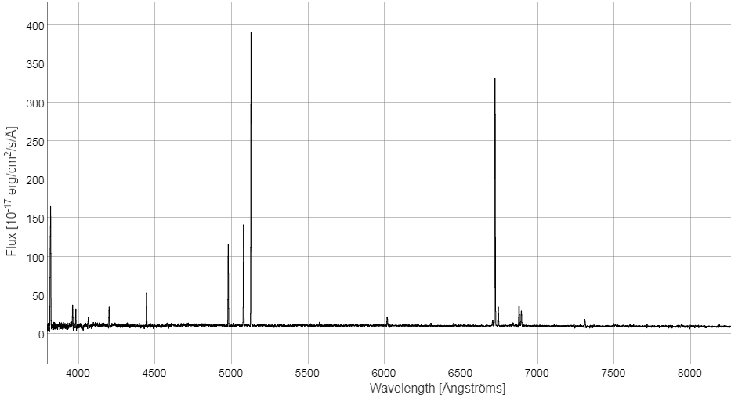
Redshift & a Spectrum
Different parts of a spectrum are visible depending on the galaxy’s redshift.
Notes:
The range of wavelengths we measure in a spectrum are in our frame of reference. We correct these values to the rest-frame wavelength in order to study any of the transitions we require for analysis. The difference between the measured and rest-frame wavelength is the redshift of a galaxy (how much the light has been shifted towards longer (redder) wavelengths).
As a result, we see different parts of a galaxy’s spectrum depending on its redshift.

Slide 56

O⁺ abundance approximation
Developing a substitute for the [Oii] λ3727 doublet, we can now study SDSS dwarf galaxies at redshifts z < 0.02
Notes:
The [OII] 3727 doublet (required to measure the amount of singly ionized oxygen in a galaxy) is not redshifted into the SDSS spectrograph until at a redshift of about 0.02. Since dwarf galaxies are only observed out to a redshift of 0.03, this eliminates a significant portion of our sample.
By deriving this approximation, our sample size increased from 135 dwarf galaxies to almost 2000!

Slide 57
How is O⁺⁺/H related to O/H?
Different relationship for SF and AGN/composite galaxies
Douglass et al. (2017)
Notes:
For other elements, when a particular ionization stage is immeasurable for one reason or another, we can use an ICF to estimate the total elemental abundance based off one ionization stage. Usually, with oxygen, all main stages are detectable, so there is no need for one. However, I feel we should be able to discover a relation between O++/H and O/H, which would allow us to measure the metallicity of dwarf galaxies closer than z = 0.02 (since we would no longer require [OII] 3727).

Slide 58
Douglass et. al (2017)
 | Star-forming (dwarf) | Star-forming | AGN & composite
Slope | 0.84 ± 0.013 | 0.824 ± 0.0010 | 0.764 ± 0.0035
y-intercept [log(ICF)] | 1.61 ± 0.094 | 1.787 ± 0.0065 | 2.05 ± 0.023
Notes:
AGN and composite galaxies are grouped together.
AGN and composite galaxies have more doubly-ionized oxygen than star-forming galaxies. This makes sense, since they have a more energetic emission with which to ionize the gas.
The slope should be equal to 1 in both cases.

Slide 59
Dwarf sample increase
 | Without approximation | With approximation
Void dwarf galaxies | 42 | 993
Wall dwarf galaxies | 89 | 759
Uncertain dwarf galaxies | 4 | 168
Notes:
Describe what “uncertain” dwarf galaxies are.

Slide 60
Sample dwarf galaxy
www.sdss.org
12 + log(O/H) = 8.35 ± 0.159
12 + log(N/H) = 7.05 ± 0.118
log(N/O) =
-1.31 ± 0.198
SDSS DR7 galaxy spectrum – www.sdss.org
Notes:
Average (median) values for void dwarf galaxies
O/H: 8.02±0.008 (8.09) – higher than average
N/H: 6.60±0.007 (6.62) – higher than average
N/O: -1.42±0.010 (-1.41) – higher than average
Spectra of central region in void dwarf galaxy.
normal late-type spiral galaxy (determined by GalaxyZoo)
Mr = -16.849

Slide 61
Comparison to previously published values
Douglass et al. (2017)
Notes:
Strong-line methods (as those used by Tremonti et al. 2004) can overestimate the metallicity abundance by as much as 0.3 dex. (Kennicutt et al. 2003)

Slide 62
Mass – Metallicity relationship
Douglass et al. (2017)
Notes:
There is a known relationship between the stellar mass of a galaxy and its metallicity – the more stars a galaxy has, the more of its hydrogen has been converted into heavier elements.

Slide 63
Large-scale environmental dependence of gas-phase oxygen (O/H)
M_{r} range | Average shift
Dwarf galaxies | -0.03±0.012 (7%)
-17 > M_{r} > -18 | -0.02±0.015 (5%)
-18 > M_{r} > -19 | -0.00±0.014 (0%)
-19 > M_{r} > -20 | -0.04±0.016 (10%)
Dwarf galaxies
Douglass et al. (2017)
Douglass et al. (2017)
Notes:
Metallicities calculated w/ approximations
Evidence that void dwarf galaxies have slightly higher O/H values (7%) than wall galaxies – subtle difference, but statistically significant.

Slide 64
Metallicity dependence for dwarf galaxies
M_{r} > -14
-14 > M_{r} > -15
-15 > M_{r} > -16
-16 > M_{r} > -17
Notes:
P-values (from KS test) steadily decrease from 0.4645 at Mr > -14 to 0.0036 for -16 > Mr > -17. There is a statistically significant difference between the void and wall metallicities, but it is not physically significant.

Slide 65
O/H dependence for galaxies up to L*
M_{r} > -17
-17 > M_{r} > -18
M_{r} > -17
-0.03±0.012 (7%)
-17 > M_{r} > -18
-0.02±0.015 (5%)
-18 > M_{r} > -19
-0.00±0.014 (0%)
-19 > M_{r} > -20
-0.04±0.016 (10%)
-18 > M_{r} > -19
-19 > M_{r} > -20
Notes:
There is a statistically significant difference between the void and wall metallicities, but it is not physically significant.
All magnitude bins are shifted in the same direction.
The direct method cannot be trusted for non-dwarf galaxies, because the [OIII] 4363 auroral line becomes too weak to accurately detect at metallicities higher than 8.5. The [OIII] flux ratio is being underestimated in these galaxies, resulting in an overestimate of the temperature and therefore an underestimate of the metallicity. This is why there appears to be a shift towards lower metallicities as the magnitude increases.

Slide 66
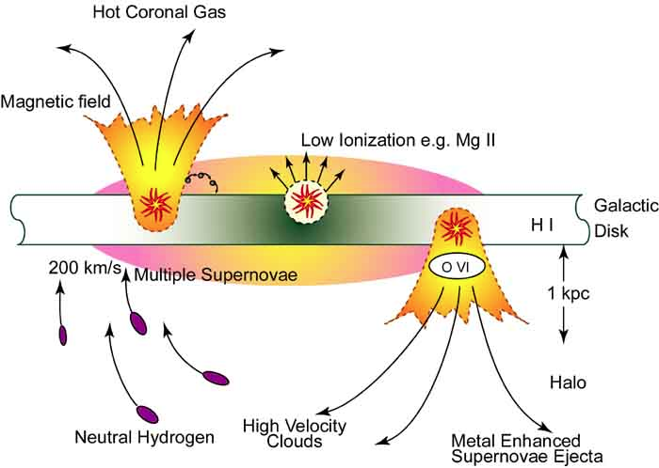
Contributions to metallicity
Increases metallicity
Decreases metallicity
Star formation due to
Galactic interactions
Internal secular evolution
Supernovae
Infall of metal-rich gas
Infall of pristine gas
Supernova-driven winds
Galactic interactions
Unknown artist, FIMS, Space Science Lab, NASA
Notes:
Increases
Nucleosynthesis – initially pristine gas is converted into metals in stars
Supernovae – expel metal-rich gas into ISM
Metal-rich gas (from earlier supernova) falls back into galaxy
Galactic interactions induce burst of star formation
Decreases
Relatively pristine gas falls into galaxy
Stellar winds blow metal-rich gas out of galaxy
Galactic interactions strip metal-rich gas from center

Slide 67
Chemical enrichment of ISM
IGM or ICM
H
Z,H
ISM
Z + H
CGM
Notes:
Heavier elements are fused via nucleosynthesis in stars within in the ISM. These metals contaminate the ISM from stellar winds and supernovae.
Metal-rich gas from supernovae expelled from ISM to CGM (H is cooler, since the majority of it exiting with the metals is from the surrounding ISM and not from the supernovae, so it does not travel as far through the CGM as the heavier metals)
Pristine gas (H) falls onto CGM from IGM or ICM
Mixture of H, metal-rich gas in CGM falls back onto ISM
Cen (2011) shows that the IGM of a wall galaxy has an entropy higher than the threshold for cooling (cooling time of gas in is equal to Hubble time), so the H will not condense in IGM/ICM to fall back onto CGM

Slide 68



M_{DM halo}/M* larger in void galaxies?
Void central galaxy
Wall central galaxy
DM
DM
Simulation results of Jung et al. (2014) and Tonnesen & Cen (2015)
Notes:
Higher O/H in void dwarf galaxies
Simulations by Jung et al. (2014) and Tonnesen & Cen (2015) show that DM halos of void central galaxies are larger than that of wall central galaxies for a fixed stellar mass.

Slide 69
HI mass dependence on large-scale environment
Dwarf galaxies
Douglass et al. (2017)
Douglass et al. (2017)
Notes:
For a fixed stellar mass, void dwarf galaxies have higher HI masses than wall dwarf galaxies.
Gas is cooler in void regions, so void galaxies have higher HI masses for a given stellar mass.

Slide 70
Nitrogen synthesis
Nitrogen behaves as both a primary and secondary element, depending on the initial metallicity of the star.
Low-metallicity star
High-metallicity star
H
C
H
H
H
H
O
H
C
H
H
H
C,O,N
all produced in same ratio
N produced in higher
ratio than C,O
Notes:
Yields of primary elements (oxygen, carbon) are independent of the initial metallicity of the star.
Yields of secondary elements depend on the star’s initial metallicity.
The CNO cycle can commence earlier in a star which has an initial C abundance above the critical value for the CNO cycle. As a result, stars formed with higher metallicities can produce more N relative to the primary elements than in a metal-poor star.

Slide 71
Mass – log(N/O) relationship
Same slope for both void and wall galaxies, but the critical mass for the N/O plateau is lower for void galaxies (≈7.2) than wall galaxies (≈7.6)
Douglass et al. (2017)
Notes:
While void and wall galaxies follow the same positive slope, the turn-off for the “N/O plateau” is at a higher mass (~7.6) for wall galaxies than voids (~7.2). A higher critical mass for the void dwarf galaxies indicates that they are reserving more of the heavy elements and are able to commence secondary nitrogen production earlier than the dwarf galaxies in denser regions.

Slide 72
O/H – N/O relationship
We find an inverse relationship between N/O and O/H instead of a constant N/O “plateau” predicted for primary N production.
Douglass et al. (2017)
Notes:
The “N/O plateau” is supposed to be indicative of the primary v. secondary nature of nitrogen. It is seen in both the mass-N/O relation and the O/H v. N/O relation.
Binned by stellar mass in widths of 0.1.
Expected to be constant up to Z~8 or 8.5, then steady increase. Not quite sure why we instead see an inverse relation between O/H and N/O – this translates to a constant N for increasing O (which does not make sense).
Select other studies (including Andrews & Martini, 2013) also find a negative slope instead of a constant N/O value as a function of O/H.

Slide 73
O/H – N/H relationship
Evidence of two evolutionary tracks, one with a much steeper slope than the other
Douglass et al. (2017)
Notes:
Shallower slope corresponds to those galaxies with an inverse relationship between the N/O ratio and metallicity.
Steeper slope corresponds to those galaxies on the N/O plateau.

Slide 74
Nitrogen abundance dependence on large-scale environment
Void dwarf galaxies have lower N/H values by an average of 0.04±0.011 or about 10%.
Douglass et al. (2017)
Douglass et al. (2017)
Notes:
Slight evidence for void galaxies to have lower N/H values (10%) than wall galaxies.

Slide 75
N/H dependence for dwarf galaxies
M_{r} > -14
-14 > M_{r} > -15
-15 > M_{r} > -16
-16 > M_{r} > -17

Slide 76
N/H dependence for galaxies up to L*
M_{r} > -17
-17 > M_{r} > -18
M_{r} > -17
0.04±0.010 (10%)
-17 > M_{r} > -18
-0.03±0.011 (7%)
-18 > M_{r} > -19
-0.00±0.010 (0%)
-19 > M_{r} > -20
-0.02±0.011 (5%)
-18 > M_{r} > -19
-19 > M_{r} > -20
Notes:
There is a statistically significant shift in most of the magnitude bins, but they are not physically significant.
Dwarf galaxies are more sensitive to large-scale environmental effects than larger galaxies.

Slide 77
Large-scale environmental dependence of N/O
M_{r} range | Average shift
Dwarf galaxies | 0.07±0.016 (17%)
-17 > M_{r} > -18 | -0.00±0.019 (0%)
-18 > M_{r} > -19 | 0.00±0.018 (0%)
-19 > M_{r} > -20 | 0.02±0.020 (5%)
Dwarf galaxies
Douglass et al. (2017)
Douglass et al. (2017)
Notes:
There is clearly a shift in the N/O abundance between void and wall dwarf galaxies – void galaxies have a lower N/O abundance than wall galaxies (17%). A statistically significant, and surprising, result.
The subtle difference in O/H and N/H between voids and more dense regions is within the noise of the data, but when we remove H from the ratio, we amplify the difference and can see it in N/O.
Void galaxies have slightly higher O/H ratios than wall galaxies.
Void galaxies have slightly lower N/H ratios than wall galaxies.

Slide 78
N/O dependence for dwarf galaxies
M_{r} > -14
-14 > M_{r} > -15
-15 > M_{r} > -16
-16 > M_{r} > -17
Notes:
P-values (from KS test) steadily decrease from 0.3166 at Mr > -14 to 0.1002 for -16 > Mr > -17. There is a statistically significant difference between the void and wall metallicities, but it is not physically significant.

Slide 79
N/O dependence for galaxies up to L*
M_{r} > -17
-17 > M_{r} > -18
M_{r} > -17
0.07±0.016 (17%)
-17 > M_{r} > -18
-0.00±0.018 (0%)
-18 > M_{r} > -19
0.00±0.018 (0%)
-19 > M_{r} > -20
0.02±0.020 (5%)
-18 > M_{r} > -19
-19 > M_{r} > -20
Notes:
Again, dwarf galaxies exhibit the strongest large-scale environmental dependence of the chemical abundances.
The shift towards higher N/O values indicates the additional N (relative to O) produced in more massive galaxies. This matches the idea that N behaves as both a primary and secondary element. In more massive galaxies (with more O/H present than in dwarfs), there is more of the heavy metals to be able to produce N at an earlier stage in the galaxy’s lifetime.

Slide 80
Oxygen, Nitrogen synthesis
Larger stars die first, creating a time delay between the release of oxygen and nitrogen.
Nitrogen
4 M⊙
8 M⊙
Oxygen
Notes:
Oxygen is primarily produced in more massive stars (M* > 10^4), while nitrogen is also produced in more intermediate mass stars (10^4 < M* < 10^8).

Slide 81
Is cosmic downsizing influenced by the environment?
Lower N/O in void dwarf galaxies might indicate a more constant SFR for void galaxies than for galaxies in more dense environments.
Wall galaxy
Void galaxy?
SFR
Time
Based off the Lilly-Madau plot (Madau et al. 1996)
Notes:
Cosmic downsizing – shift in star formation towards lower mass objects closer to present epoch. We find that there is also a shift in star formation towards lower density regions.
Cosmic downsizing thought to occur around z~1-2
A more constant star formation rate would produce lower N relative to O than an initially high star formation rate that has since reduced. Cosmic downsizing would reduce the star formation rate at late times much more in wall galaxies than in void galaxies. Allowing the initial metallicity in stars to build up earlier in wall galaxies than in voids, wall galaxies would have a higher N/O ratio than void galaxies. This observation was suggested by van Zee & Haynes (2006), as a result of the additional O released in the void galaxies as a result of the ongoing star formation.

Slide 82
HI mass – abundance relationships
Douglass et al. (2017)
Douglass et al. (2017)
Notes:
For a given stellar mass, the N/O ratio decreases with increasing HI mass. A time delay between the production of N and O will cause the N/O ratio to decrease with increasing HI mass, since more evolved galaxies have higher N/O ratios and will have used up more of their neutral hydrogen.
There is no relationship between the metallicity and HI mass.

Slide 83
Color - abundance relations
Douglass et al. (2017)
Blue
Red
Douglass et al. (2017)
Notes:
Young galaxies are characteristically blue and should have a lower metallicity than older galaxies, which are normally more red.
Time delay between release of N and O results in a positive correlation between the color and N/O ratio.

Slide 84
specific Star Formation Rate (sSFR) – abundance relations
Douglass et al. (2017)
Douglass et al. (2017)
Notes:
Since mass is inversely proportional to total specific star formation rate, and mass is proportional to metallicity, then the total specific star formation rate should be inversely proportional to the metallicity.
If O is produced in more massive stars than N, then galaxies with higher sSFRs will have more O (and therefore a lower N/O ratio) than galaxies with lower sSFRs.

Slide 85
Chemical abundances of SHELS galaxies
“Large-scale environmental dependence of gas-phase abundances in dwarf galaxies from SHELS”
Calculate abundances using an alternate method to the Direct T_{e} method, since the data does not have a high enough S/N to detect the [Oiii] λ4363 auroral line

Slide 86
Small-scale environment
“The influence of the small-scale environment on dwarf galaxy evolution”
Work done in collaboration with Brean Prefontaine and Daniele Schneider
For dwarf galaxies, does their nearest bright neighbor have more influence on their formation and evolution than the large-scale environment in which they live?

Slide 87
Color as a function of distance
Notes:
Void galaxies are slightly bluer than wall galaxies.
The proximity of another galaxy only has an affect on the target galaxy’s color within 0.05 Mpc/h or 0.1 r_vir.

Slide 88
sSFR as a function of distance
Notes:
Void galaxies have higher sSFRs than wall galaxies.
The proximity of another galaxy only has an affect on the target galaxy’s sSFR within 0.05 Mpc/h or 0.1 r_vir.

Slide 89
Metallicity as a function of distance
Notes:
Void galaxies have higher metallicities than wall galaxies.
The proximity of another galaxy only has an affect on the target galaxy’s metallicity within 0.05 Mpc/h or 0.1 r_vir.

Slide 90
Nitrogen abundance as a function of distance
Notes:
Void galaxies have lower nitrogen abundances than wall galaxies.
There is no affect on the nitrogen abundance due to the proximity of a neighbor.

Slide 91
N/O ratio as a function of distance
Notes:
Void galaxies have lower N/O ratios than wall galaxies.

Slide 92
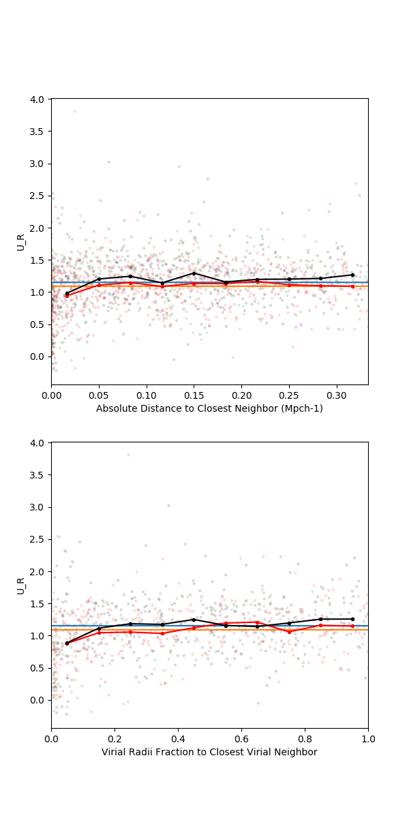
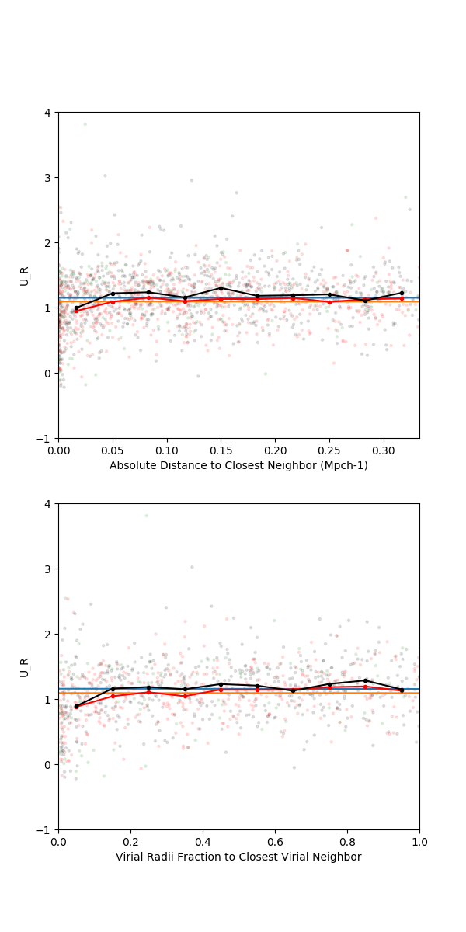
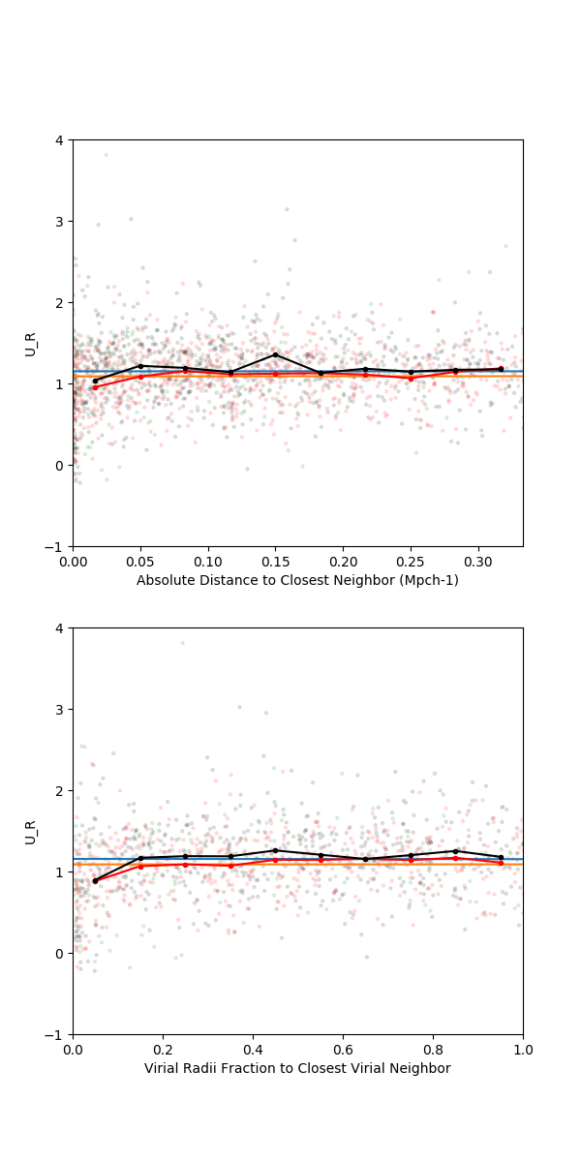
Influence of peculiar velocity limit
150 km/s
300 km/s
600 km/s
Notes:
No differences with different maximum peculiar velocity limit

Slide 93
Influence of galaxy sample
Those with abundances
All dwarf galaxies
Notes:
Different results based on the sample of dwarf galaxies.
Those with abundances show a trend towards bluer colors at close distances to the neighbor and little overall relationship between the color and distance.
The entire dwarf galaxy sample shows a trend towards redder colors as an overall function of distance to the nearest neighbor. There is a slight drop in the color at small distances for wall galaxies only. Void galaxies show very little relationship between distance to nearest neighbor and color.

Slide 94
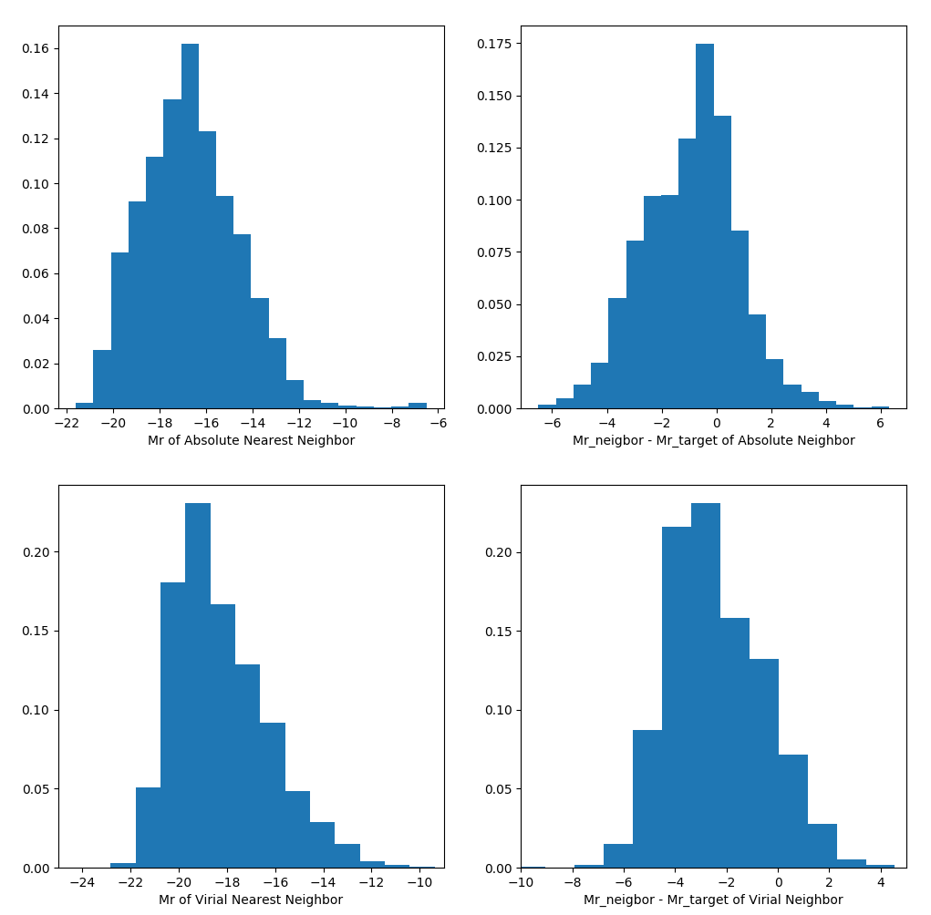
Magnitudes of nearest neighbors
Notes:
Closest galaxy to dwarf is often of equal or fainter magnitude than the target galaxy.
Using the virial radius of the neighbor galaxy finds a brighter galaxy than the target galaxy.

Slide 95
Including the redshift in the distance
Without redshift
With redshift
Notes:
Gap in distribution appears when we include redshift. Those galaxies still within 0.05 Mpc/h are most likely interacting and/or merging.

Slide 96
Green Valley Galaxies
Identifying Green Valley galaxies
Work done in collaboration with Jinfu Dai for his senior thesis

Slide 97
Optical color-magnitude diagram
“Red Cloud”
“Blue Sequence”
Notes:
Easily fit by sum of two Gaussians

Slide 98
NUV-r color-magnitude diagram

Slide 99
Stellar mass distribution of GV galaxies
Notes:
Same as galaxies in the Red Cloud

Slide 100
(s)SFR distributions of GV galaxies

Slide 101
Fraction of galaxies in CMD classes

Slide 102
Abundance distributions of GV galaxies

Slide 103
Abundance distributions of AGN

Slide 104
The chemical evolution of AGNs
Nitrogen abundances are much higher than expected in AGN, while the oxygen abundances are normal. Why is this?

Slide 105
Metallicity dependence for AGN up to L*
-18 > M_{r} > -19
-19 > M_{r} > -20
Notes:
No significant difference between SF and AGN galaxies in O/H values.

Slide 106
N/H dependence for AGN up to L*
-18 > M_{r} > -19
-19 > M_{r} > -20
Notes:
Unlike the O/H abundance ratio, the N/H ratio in AGNs is much higher than that in SF galaxies.

Slide 107
N/O dependence for AGN up to L*
-18 > M_{r} > -19
-19 > M_{r} > -20
Notes:
The difference between SF and AGN/composite galaxies becomes much stronger in N/O.
These tell us that there is more N than O in AGN. Why would the ionization source influence the relative abundances of different elements?

Slide 108
Large-scale environmental influence on dwarf galaxy evolution
void
Void dwarf galaxies have higher O/H values than dwarf galaxies in more dense regions → larger M_{DM halo}/M* ratios in void galaxies?
Void dwarf galaxies have lower N/O ratios than dwarf galaxies in more dense regions → observational evidence of environmentally dependent cosmic downsizing?
wall
Time

Slide 109

Thank you!
Advisor: Prof. Michael Vogeley
Collaborators: Renyue Cen (Princeton University), Jabran Zahid (Harvard-Smithsonian Center for Astrophysics)
Fellow graduate students: Dr. Crystal Moorman, Ginny Price, Dr. Vishal Kasliwal, Dr. Danny Pan
Undergraduates: Brean Prefontaine, Salvatore Zerbo, Jinfu Dai, Daniele Schneider
Funding provided by NSF grant AST-1410525

Slide 110
Large-scale environmental influence on dwarf galaxy evolution
void
Void dwarf galaxies have higher O/H values than dwarf galaxies in more dense regions → larger M_{DM halo}/M* ratios in void galaxies?
Void dwarf galaxies have lower N/O ratios than dwarf galaxies in more dense regions → observational evidence of environmentally dependent cosmic downsizing?
wall
Time
Douglass, K.A. & Vogeley, M.S. 2017a, ApJ, 834: 186-198, arXiv: 1604.08599
Douglass, K.A. & Vogeley, M.S. 2017b, ApJ, 837: 42-55, arXiv: 1612.04908
Douglass, K.A., Vogeley, M.S. & Cen, R. 2017, submitted to ApJ, arXiv: 1706.07099

Slide 111
Sources
Cen, R. 2011, ApJ, 741, 99
Cooper, M.C., Tremonti, C.A., Newman, J.A., & Zabludoff, A.I. 2008, MNRAS, 390, 245
De Robertis, M.M., Dupour, R.J., and Hunt, R.W.. 1987, JRASC, 81, 195
Deng, X.-F. 2011, AJ, 141, 162
Douglass, K.A. & Vogeley, M.S. 2017a, ApJ, 834, 186
Douglass, K.A. & Vogeley, M.S. 2017b, ApJ, 837, 42
Douglass, K.A., Vogeley, M.S., & Cen, R. 2017, submitted to ApJ, arXiv: 1706.07099
Filho, M.E., Sánchez Almeida, J., Muñoz-Tuñón, C., et al. 2015, ApJ, 802, 82
Goldberg, D.M., Jones, T.D., Hoyle, F., et al. 2005, ApJ, 621, 643
Gottlöber, S., Lokas, E.L., Klypin, A., & Hoffman, Y. 2003, MNRAS, 344, 715
Hoyle, F., & Vogeley, M.S. 2002, ApJ, 566, 641
Jung, I., Lee, J., & Yi, S.K. 2014, ApJ, 511, 639
Kniazev, A.Y., Grebel, E.K., Hao, L., and Strauss, M.A.. 2003, AJ, 593, L73
Madau, P., Ferguson, H.C., Dickinson, M.E., et al. 1996, MNRAS, 283, 1388
Mizushima, M.. Quantum Mechanics of Atomic Spectra and Atomic Structure. W.A. Benjamin, Inc., New York, NY (1970)
Moorman, CM., Vogeley, M.S., Hoyle, F., et al. 2014, MNRAS, 444, 3559
Osterbrock, D.E.. Astrophysics of Gaseous Nebulae and Active Galactic Nuclei. University Science Books, Mill Valley, CA (1989)
Palma, C. (2011) Kirchhoff’s Law and Spectroscopy. Retrieved from https://www.e-education.psu.edu/astro801/content/l3_p6.html
Pustilnik, S., Engels, D., Kniazev, A., et al. 2006, AstL, 32, 228
Pustilnik, S., Martin, J., Tepliakova, A., & Kniazev, A. 2011a, MNRAS, 417, 1335
Pustilnik, S., Tepliakova, A., & Kniazev, A. 2011b, AstBu, 66, 255
Pustilnik, S.A., Martin, J.-M., Lyamina, Y.A., & Kniazev, A.Y. 2013, MNRAS, 432, 2224
Pustilnik, S.A. 2014, ArXiv:1412.1316
Tonnesen, S. & Cen, R. 2015, ApJ, 812, 104
Tremonti, C.A., Heckman, T.M., Kauffmann, G., Brinchmann, J., Charlot, S., White, S.D., Seibert, M., Peng, E.W., Schlegel, D.J., Uomoto, A., Fukugita, M., and Brinchmann., J. 2004, ApJ, 613, 989

